Slide 1

Causal Discovery for Effective Connectivity in Human Brains
December 18nd 2013
Ramon Janssen, Tom de Ruijter
Supervision by Max Hinne, Tom Claassen

Slide 2
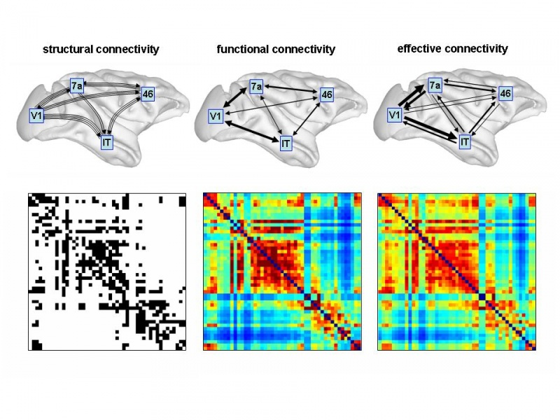
Brain Connectivity (Kan waarschijnlijk weg)

Slide 3
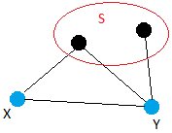
Algorithm: Structure with PC
Take a two connected points X and Y
Test whether X and Y are statistically independent given any set S of other points
If so, remove the edge between X and Y. S is recorded as a separating set of {X, Y}
“Standard” PC stops after finding one set.
Our adjusted version tries to find multiple sets
Repeat for all pairs and all sets…

Slide 4
Algorithm: direction with PC
Using the structure from the previous step, find V-structures
Orient V-structures depending on the separating sets
Our adjusted version does an additional statistical test
Some other simple rules to orient edges

Slide 5
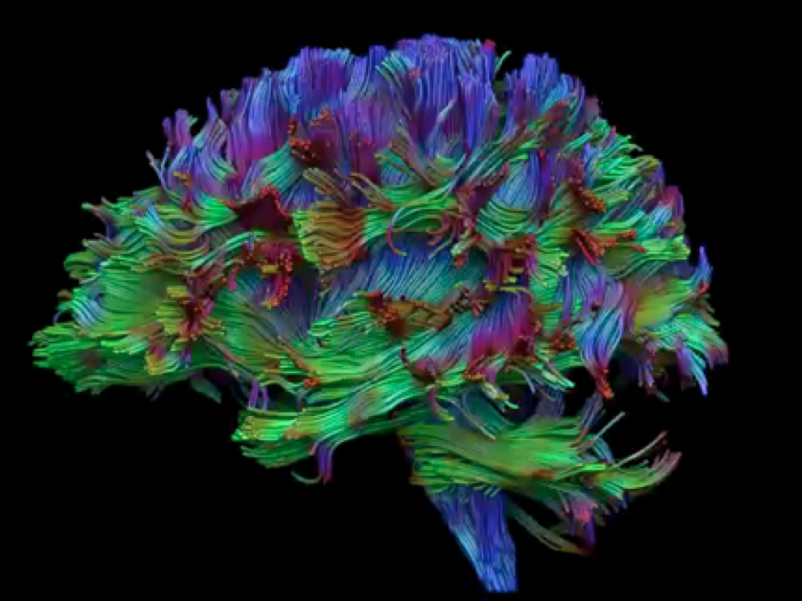
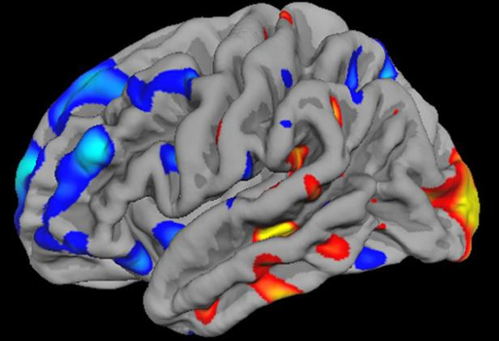
What we have (Kan waarschijnlijk weg)
fMRI and DTI data of six subjects
fMRI
DTI

Slide 6
What we have
fMRI (Functional magnetic resonance imaging) measurements
Activity of the brain
For 116 brain regions and 1029 time frames

Slide 7
What we have (Kan waarschijnlijk weg)
DTI measurements
Connectivity of the brain, according to Hinne et al.
For each pair of the 116 brain regions, whether they are connected
Binary, square matrix

Slide 8
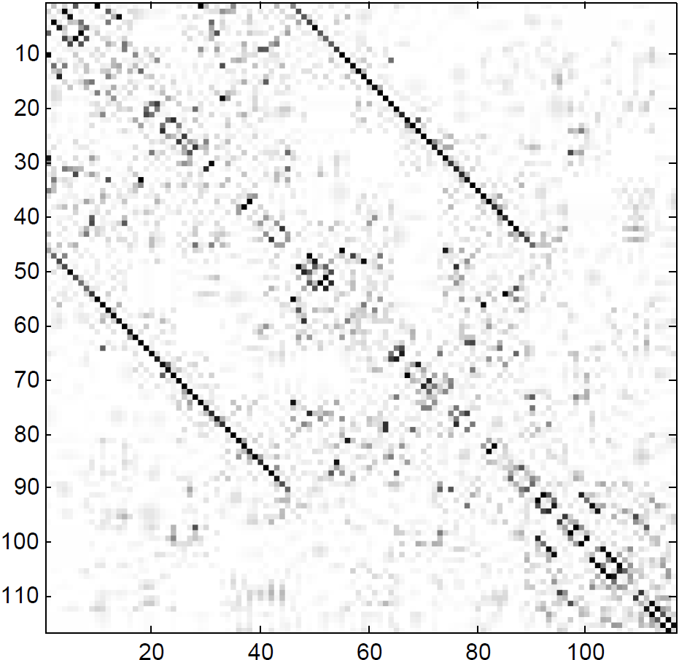

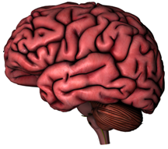
Structure
Left hemisphere
Right hemisphere
Cerebellum
Left hemisphere
Right hemisphere
Cerebellum

Slide 9
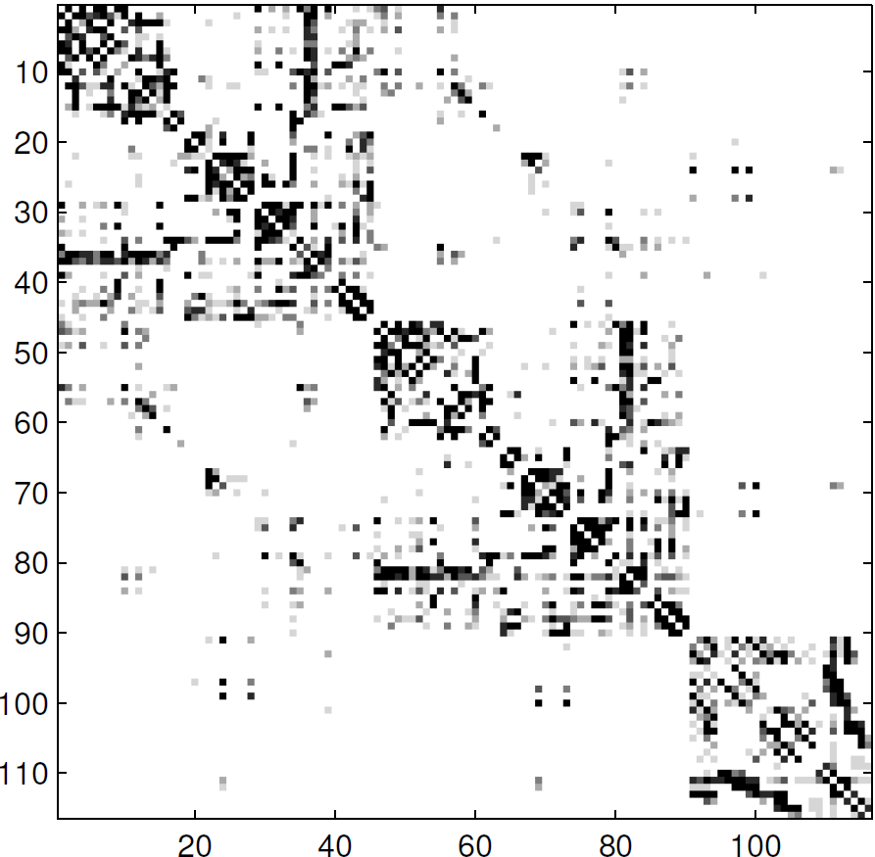
Structure
Found by Hinne at al:
Found with PC:

Slide 10
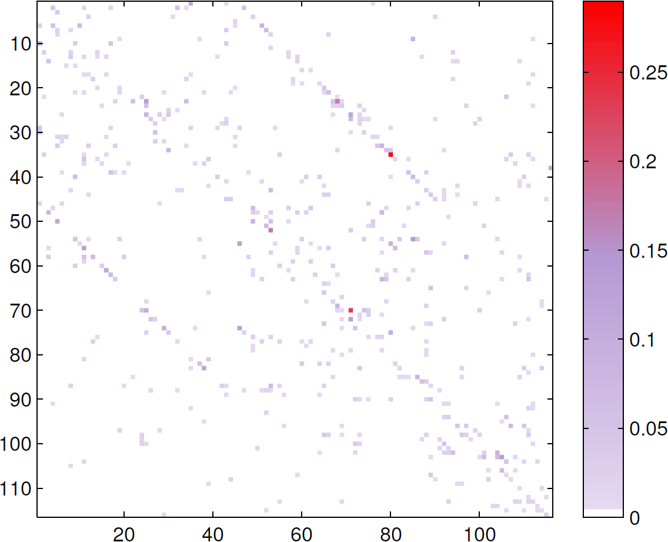
Direction
Many double arrows and little single-oriented arrows
Little consistency between subjects and regions

Slide 11

Thank you for your attention

